Slide 1
101
CRITICAL DAYS OF SUMMER
NAVAL SAFETY CENTER
2020
Image by Briana Tozour

Slide 2
Almost Summer
Summer is almost upon us and it is, once again, time for the Summer Safety Campaign. The 101 Critical Days of Summer begins on Memorial Day weekend and ends after Labor Day. Summer is the largest vacation period of the year. As the restrictions of COVID-19 begin to relax across the country, there will be an increase in people who are out enjoying the sunshine and warm weather swimming, boating, playing, and having a good time. It’s also a time of celebration, recreation, staying awake long hours, and driving more miles than your body has the energy for. With all those fun summer activities, the following safety tips are offered to make your summer a safe and happy one.
MANAGING YOUR RISK
Each year from FY13-FY19, the Navy lost an average of 13 Sailors and 8 Marines in off-duty mishaps. Do your part – we can’t afford to lose Sailors and Marines to preventable off-duty mishaps.
Image by Angelo Pantazis

Slide 3
Alcohol and Water Recreation
From FY15-FY19, there were 79 off-duty Navy and 75 off-duty USMC cases where alcohol was a contributing factor to the mishap. Impaired Judgment + Poor vision + Delayed or Slow Reaction Time = MISHAP. In FY19 alone, there were 22 Navy and 11 USMC cases.
Afloat Drinking
The CDC reports that alcohol is involved in 70% of deaths related to water recreation. It’s not a risk worth taking!
Did you know:
A boat operator is likely to become impaired quicker than a driver, drink for a drink?
The penalties for BUI can include significant fines, revocation of operator privileges, and severe jail terms?
The use of alcohol is involved in about a third of all recreational boating fatalities?
Image by Avi Richards

Slide 4
Water-related Activities
From FY14-FY18, the Navy lost eight Sailors in water-related mishaps. There were zero water-related deaths in 2019. Water-related accidents do not discriminate: junior enlisted, senior enlisted, warrant officers, junior officers, and senior officers all succumb to the dangers of being around the water. FY19 had 35 injuries.
The U.S. Coast Guard reported 4,291 mishaps that involved 658 deaths, and 2,629 injuries and approximately $46 million of damage to property as a result of recreational boating accidents in 2017.
Image by Drew Dau

Slide 5
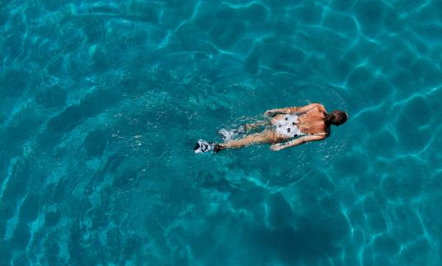
Pool Security:
Pool Security:
Use an approved safety cover and keep the pool covered when not in use.
Never allow children access to the pool without adult supervision.
Fence and lock your pool. Consider installing a water surface tension alarm.
Use an approved safety cover and keep the pool covered when not in use.
Never allow children access to the pool without adult supervision.
Fence and lock your pool. Consider installing a water surface tension alarm.
Wear a life jacket:
If you or a family member is a weak or non-swimmer, wear a coast guard-approved life vest. It’s nothing to be embarrassed about and many facilities provide them at no charge.
Diving Security:
Diving Security:
Always test water depth before diving. If you are unable to see below the water’s surface, don’t dive.
NEVER dive into rivers or other moving bodies of water. Keep your arms extended above your head when diving.
Always test water depth before diving. If you are unable to see below the water’s surface, don’t dive
NEVER dive into rivers or other moving bodies of water. Keep your arms extended above your head when diving.
Look for lifeguards:
It is always best to swim in an area supervised by lifeguards, but remember, lifeguards are the last line of defense when all other layers of protection fail.
Never Leave Children Unattended:
Don’t drink alcohol:
Avoid alcoholic beverages before or during swimming, boating or engaging in other water-related activities. Never drink alcohol while supervising children around water. Teach teenagers about the danger of drinking alcohol while swimming or boating.
Never Leave Children Unattended:
Parents are the first line of defense in keeping kids safe in the water. Never leave children unattended near water, not even for just a minute.
If your child is in the water, you should be too! Constant, undistracted supervision and barriers such as pool fencing are necessary even when children have completed swimming classes.
Parents are the first line of defense in keeping kids safe in the water. Never leave children unattended near water, not even for just a minute.
If your child is in the water, you should be too! Constant, undistracted supervision and barriers such as pool fencing are necessary even when children have completed swimming classes.
Spit it out:
Teach kids not to drink the pool water. To prevent choking, never chew gum or eat while swimming, diving or playing in the water.
Read All Posted Signs:
Avoid water wings:
Do not use air-filled swimming aids (such as «water wings») in place of coast guard-approved life jackets or life preservers with children. Using air-filled swimming aids can give parents and children a false sense of security, which may increase the risk of drowning. These air-filled aids are toys and are not designed to be personal-flotation devices, as they can deflate or be punctured.
Read all posted signs:
Follow posted safety rules and warnings. Teach kids that being safe in and around the water is a personal responsibility - yours and theirs.
Follow posted safety rules and warnings. Teach kids that being safe in and around the water is a personal responsibility - yours and theirs.
Never Swim Alone or in Unsupervised Places:
Never swim alone or in
Unsupervised places:
Teach your children to always swim with a buddy.
Teach your children to always swim with a buddy.
Image by Filip Filkovic Philatz

Slide 7
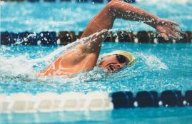
Always Be Water-Aware!
Swimming is one of life’s great pleasures. It offers many health and fitness benefits, cools you off in the summer, and provides a great opportunity to socialize with family and friends. Although water can be a lot of fun, make sure you and yours stay safe, by being water-aware.
Image by Anna Demianenko
Learn To Swim
The best thing anyone can do to stay safer in and around the water is to learn to swim. This includes both adults and children.
Note: The American Academy of Pediatrics now supports swimming classes after the age of 1 if the child is emotionally and developmentally ready.
Stock Image via Shutterstock
Watch Out
Don’t get too tired, too cold, too far from safety, exposed to too much sun, or experience too much strenuous activity. Don’t take chances by overestimating your swimming skills.
Note the weather:
Pay attention to local weather conditions and forecasts. Stop swimming at the first indication of bad weather.

Slide 8
Do Not Mix Sun And Alcohol
Boating Accidents Due to Alcohol Consumption
Both alcohol and the sun can cause dehydration. The sun causes your body to sweat in order to stay cool, and if those fluids aren't replaced, your body will undergo adverse reactions. You may feel extremely thirsty, dizzy, or fatigued. When people drink they tend to become more lackadaisical and reckless, which can have dangerous implications when water recreation or water sports are involved. In fact, up to 70% of all water recreation deaths of teens and adults involve alcohol consumption. If you are drinking in or near a body of water be aware that you may lack the dexterity needed to stay afloat, which can increase your risk of drowning (the third leading cause of unintentional injury and death worldwide and fifth in the United States). Sun and heat exposure only amplifies this risk. In addition, the physical exertion of swimming on a hot day paired with alcohol consumption can lead to overheating -a risk factor for heat syncope (fainting)- which can have deadly consequences.
According to Boat U.S. Foundation: “Stressors, such as exposure to noise, vibration, sun, glare, wind, and the motion of the water, affects boat operators and passengers, thus drinking while boating is even more dangerous than drinking and driving.
Research shows that hours of exposure to boating stressors produces a kind of a fatigue, or ‘boater’s hypnosis,’ which slows reaction time almost as much as if you were legally drunk. Adding alcohol or drugs to boating stress factors intensifies their affects—each drink multiplies your accident risk.”
That’s why boaters should NEVER drink when operating a boat. Every state has strict drinking and boating laws–you can be arrested on the water.
YES, you can get a Boating Under the Influence (BUI) punishable using the same criteria as Driving Under the Influence (DUI).

Slide 9
BOATING SAFETY
OPERATOR`S RESPONSIBILITY
Don’t drink and boat.
Boating Under the Influence (BUI) is dangerous and illegal.
Make sure the boat is in top operating condition.
Keep legally mandated safety equipment on board.
Maintain safe speed at all times to avoid a collision.
Keep an eye out for changing weather conditions and act accordingly.
Know and obey federal and state regulations and waterway markers.

Slide 10
Wear a life jacket:
If you or a family member is a weak or non-swimmer, wear a Coast Guard-approved life vest. It’s nothing to be embarrassed about and many facilities provide them at no charge.
Look for lifeguards:
It is always best to swim in an area supervised by lifeguards, but remember, lifeguards are the last line of defense when all other layers of protection fail.
Don’t drink alcohol:
Avoid alcoholic beverages before or during swimming, boating, or engaging in other water-related activities. Never drink alcohol while supervising children around water. Teach teenagers about the danger of drinking alcohol while swimming or boating.
Spit it out:
Teach kids not to drink the pool water. To prevent choking, never chew gum or eat while swimming, diving or playing in the water.
Avoid water wings:
Do not use air-filled swimming aids (such as «water wings») in place of Coast Guard-approved life jackets or life preservers with children. Using air-filled swimming aids can give parents and children a false sense of security, which may increase the risk of drowning. These air-filled aids are toys and are not designed to be personal flotation devices, as they can deflate or be punctured.
Check the water depth:
The American Red Cross recommends 9 feet as a minimum depth for diving or jumping.
Image by Matheus Frade

Slide 11
General Rules for Fireworks
NEVER allow children to play with or ignite fireworks.
Read and follow ALL warnings and instructions.
Be sure people are out of range before lighting fireworks.
NEVER try to relight fireworks that have not fully functioned.
ONLY light fireworks on a smooth, flat surface away from the house, dry leaves, and flammable materials.
In case of a malfunction or fire, keep a bucket of water (or a garden hose) and fire extinguisher at the ready.

Slide 12
Heat Aware
Heat injuries:
Heat injuries occur after several hours of physical exertion in the heat.
Symptoms: painful muscle spasms usually in the legs or abdomen.
Treatment:
Get out of the heat and into the shade. Hydrate with water or sports drink. Stretch and massage the muscle.
Prevention:
Acclimate to the environment so your body adapts to the heat. Hydrate with water or sports drink before and during exercise. Avoid exercising during the hottest part of the day. Wear light, loose clothing and use sunscreen.
Heat stroke:
A serious condition when the body’s cooling system stops working and core temperature rises to dangerous levels. If ignored, heat stroke can lead to death.
Symptoms:
Red, hot, and dry skin. Rapid but weak pulse. Rapid but shallow breathing. Confusion, faintness, staggering, hallucinations. Unusual agitation or coma.
Treatment:
Reduce body temperature by cooling the body. Remove unnecessary clothing. Apply water, cool air, wet sheets or ice on the neck, groin, and armpits to accelerate cooling. Seek professional medical attention NOW!
Prevention:
Same procedure concerning heat cramps or heat exhaustion.
Heat Exhaustion:
Due to loss of water and salt through sweat.
Symptoms: headache, nausea, dizziness, weakness, and cool, clammy skin.
Treatment:
Stop and rest. Hydrate and get into a cool room or shade. Loosen clothing and apply cool wet towels or pour cool water over the head.
Prevention: Same as heat cramp prevention.

Slide 13
Sports Injury Prevention
Warm-up and stretch BEFORE playing any sport.
Ensure you are physically able to play – see your physician for periodic physicals. Don’t participate in a sporting event without a physician’s release if you’ve had a sports injury that required medical attention.
Make sure to wear all proper protective equipment required for the sport: Shoulder pads, elbow pads, knee pads and helmet for football; batting helmets with faceguards; catcher’s face mask, throat guard, chest protector, and shin guards for baseball.
Playground Safety
Ensure children take off their bicycle helmets when playing on playground equipment.
Ensure there is soft surfacing underneath the playground equipment.
Ensure children are sitting down while swinging. Have them slow down before they get off of a swing. DO NOT let them walk near someone else who is swinging.
Ensure children use both hands when using climbers. Ensure they only climb on dry equipment to prevent them from falling.
NEVER let your child climb up the front of the slide as they may get hit by another child sliding down.
Ensure your child slides down feet first. Ensure children slide down one at a time to avoid injuries from a pile up.
SPORTS-RELATED
ACTIVITIES

Slide 14
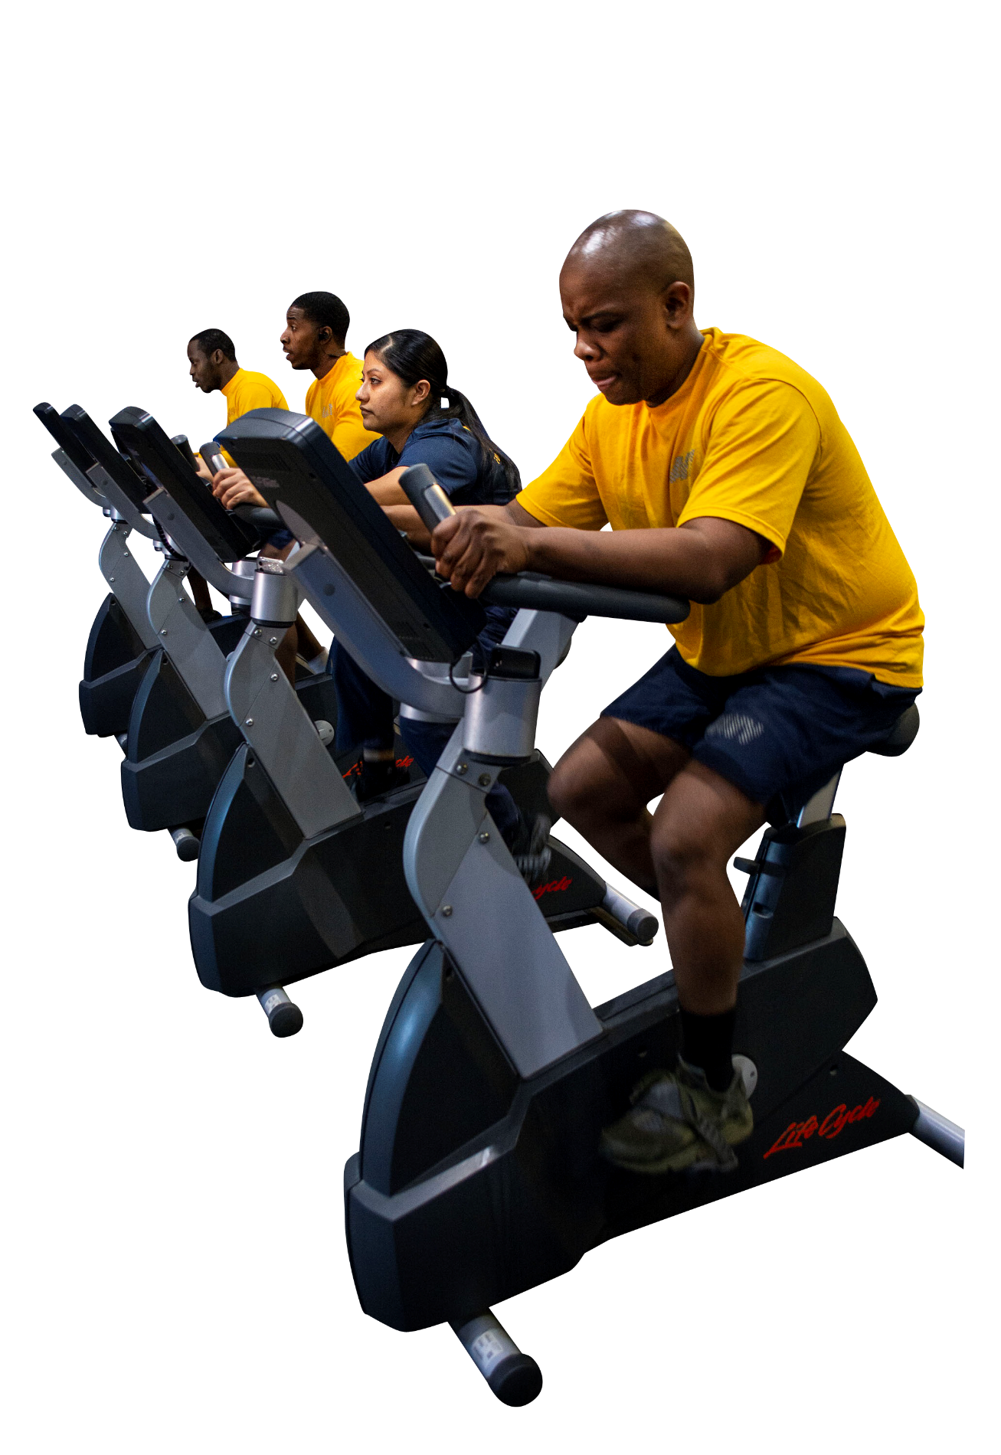
SPORTS-RELATED SAFETY
Walking, Jogging Safety
Execute warm up exercise before walking, jogging, or running.
Jog, run, or walk on sidewalks facing traffic. Exercise caution when jogging, running, or walking near roadways.
Choose good shoes for jogging, walking, or running.
Wear loose clothing with light colors. In the evening use reflective clothing.
Drink plenty of fluids (water or sports drinks) before and during a walk, jog, or run.
Watch for signs of heat cramps, heat exhaustion, or heat stroke in hot weather.
Jog, run or walk in a familiar area; carry a whistle or cell phone.
Allow a cool down period.
Image via Navy.mil

Slide 15
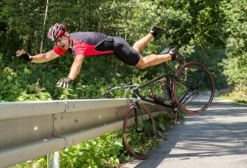
SPORTS-RELATED SAFETY
As you might expect, when a crash occurs between a vehicle and a bike, it’s the cyclist who is most likely to be injured. Find out what you can do to prevent bicycle injuries and deaths, and remember: a large percentage of crashes can be avoided if motorists and cyclists follow the rules of the road and watch out for each other.
Remember to use arm and hand signals.
Ride WITH TRAFFIC, not against it.
Always wear an approved bicycle helmet.
Avoid riding at night if possible.
If you must ride at night, install front and rear lights on your bicycle, and wear reflective clothing. It’s the law!
Stock Image via Envato Elements

Slide 16
Sports-related Key Prevention Tips:
Gear up. When children are active in sports and recreation, make sure they use the right protective gear for their activity, such as helmets, wrist guards, knee, or elbow pads.
Use the right stuff. Be sure that sports protective equipment is in good condition, fits appropriately and is worn correctly all the time—for example, avoid missing or broken buckles, or compressed or worn padding. Poorly fitting equipment may be uncomfortable and may not offer the best protection.
Get an action plan in place. Be sure your child’s sports program or school has an action plan that includes information on how to teach athletes ways to lower their chances of getting a concussion and other injuries. Get more concussion safety tips.
Pay attention to temperature. Allow time for child athletes to gradually adjust to hot or humid environments to prevent heat-related injuries or illness. Parents and coaches should pay close attention to make sure that players are hydrated and appropriately dressed.
Be a good model. Communicate positive safety messages and serve as a model of safe behavior, including wearing a helmet and following the rules.

Slide 17
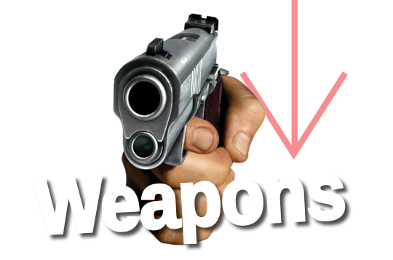
WEAPON SAFETY
Handling a weapon is simple:
Treat every weapon as if it is loaded.
NEVER point the muzzle at anything you don’t intend to shoot.
Alcohol and weapons don’t mix:
Do not handle weapons while, or after, consuming alcohol.
Complacency with privately owned weapons (POW):
Know your weapon.
Make sure you read the owner’s manual and take a class.
Everyone is a safety officer.
Intervene when you see a peer, friend, or family member handling a weapon improperly.
Treat every weapon as if it’s loaded.
Handle every weapon with care.
Identify the target before you fire.
Never point the muzzle at anything you don’t intend to shoot.
Keep the weapon on safe and your finger off the trigger until you intend to fire.
Stock Image via Envato Elements

Slide 18
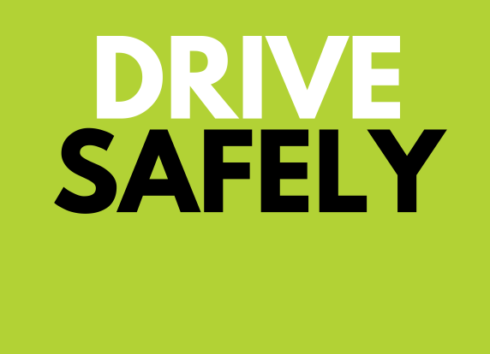
SAFE DRIVING

Slide 19
Drinking and Driving
• Impaired driving randomly kills one person in America every 48 minutes. That means you, your family, or friends could be innocent victims.
• All 50 states, the District of Columbia, and Puerto Rico have by law set a threshold making it illegal to drive with a BAC of .08 g/dL or higher.
• In 2017 there were 10,874 people killed in alcohol-impaired driving crashes. These alcohol impaired-driving fatalities accounted for 29% of all motor vehicle traffic fatalities in the United States in 2017.
• According to NHTSA, 10,511 people died in alcohol-impaired crashes in 2018. Alcohol-impaired crash fatalities accounted for 29% of all crash fatalities.
• Of the 10,874 people who died in alcohol-impaired driving crashes in 2017, there were 6,618 drivers who had BACs of .08 g/dl or higher. The remaining fatalities consisted of 3,075 motor vehicle occupants and 1,181 non-occupants.
DRIVING
YES
BAD IDEA
DRINKING

Slide 20
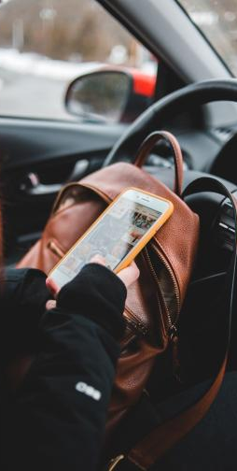
SAFE DRIVING
At any given daylight moment across America, approximately 660,000 drivers are using cellphones or manipulating electronic devices while driving.
Driving Fatigued
There are several warning signs of fatigue; however, individuals often don’t understand them or, worse, choose to ignore them.
Who is Most at Risk?
Sleep-deprived.
Driving long distances after working a full shift.
Driving through the night, the early afternoon, or at other times when normally asleep.
Drinking alcohol or taking medication that increases drowsiness.
Driving alone for long distances without rest breaks or much change in scenery.
Warning Signs!
Can’t remember the last few miles driven.
Drifting from lane or hitting a rumble strip.
Yawning repeatedly.
Difficulty focusing or keeping eyes open.
Tailgating or missing traffic signs.
Trouble keeping head up.
Image by Erik McLean

Slide 21
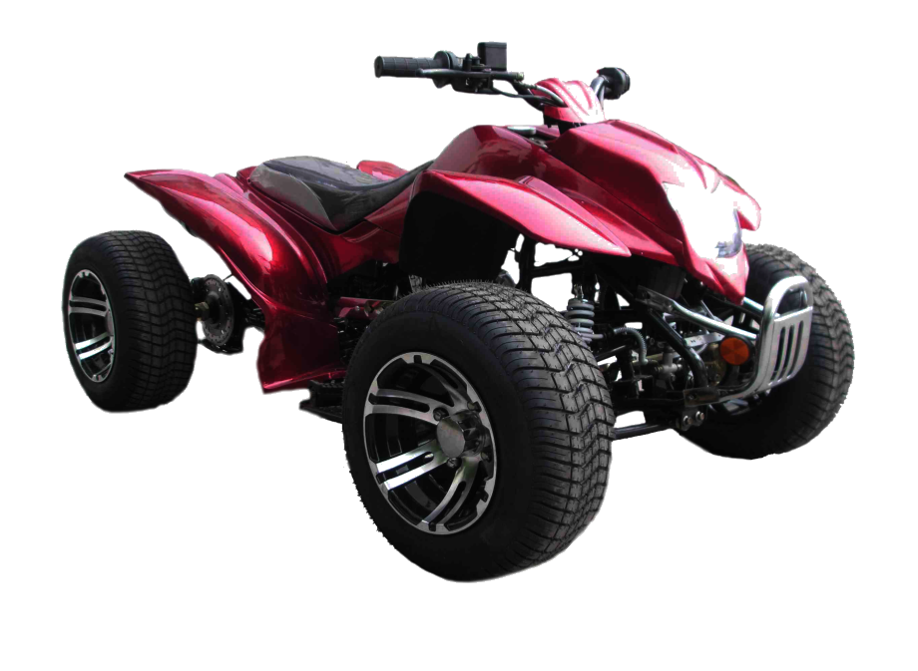
ATV / ROV SAFETY
Children and young people under the age of 16 should not ride adult
All Terrain Vehicles (ATVs) with engines bigger than 90 cubic centimeters.
Take a hands-on training course.
ALWAYS wear an approved helmet.
NEVER drive an ATV on paved roads.
NEVER drive an ATV while under the influence of drugs or alcohol.
ATVs are not toys; get training!
Never ride alone, and always tell someone where you are going and when you will return.
Read the owner`s manual carefully.
Check local laws.
Be careful when operating ATVs and Recreational Off-highway Vehicles (ROVs) with added attachments; these affect the stability, braking, and operation of the vehicle.
Always supervise young operators.
Never carry extra riders.
Never operate ATVs or ROVs on streets, highways or paved roads, except to cross at safe, designated areas.
Always make sure the ATV or ROV is in good condition.
Remember ATGATT: “All the Gear, all the Time!”
Stock Image via Envato Elements

Slide 22
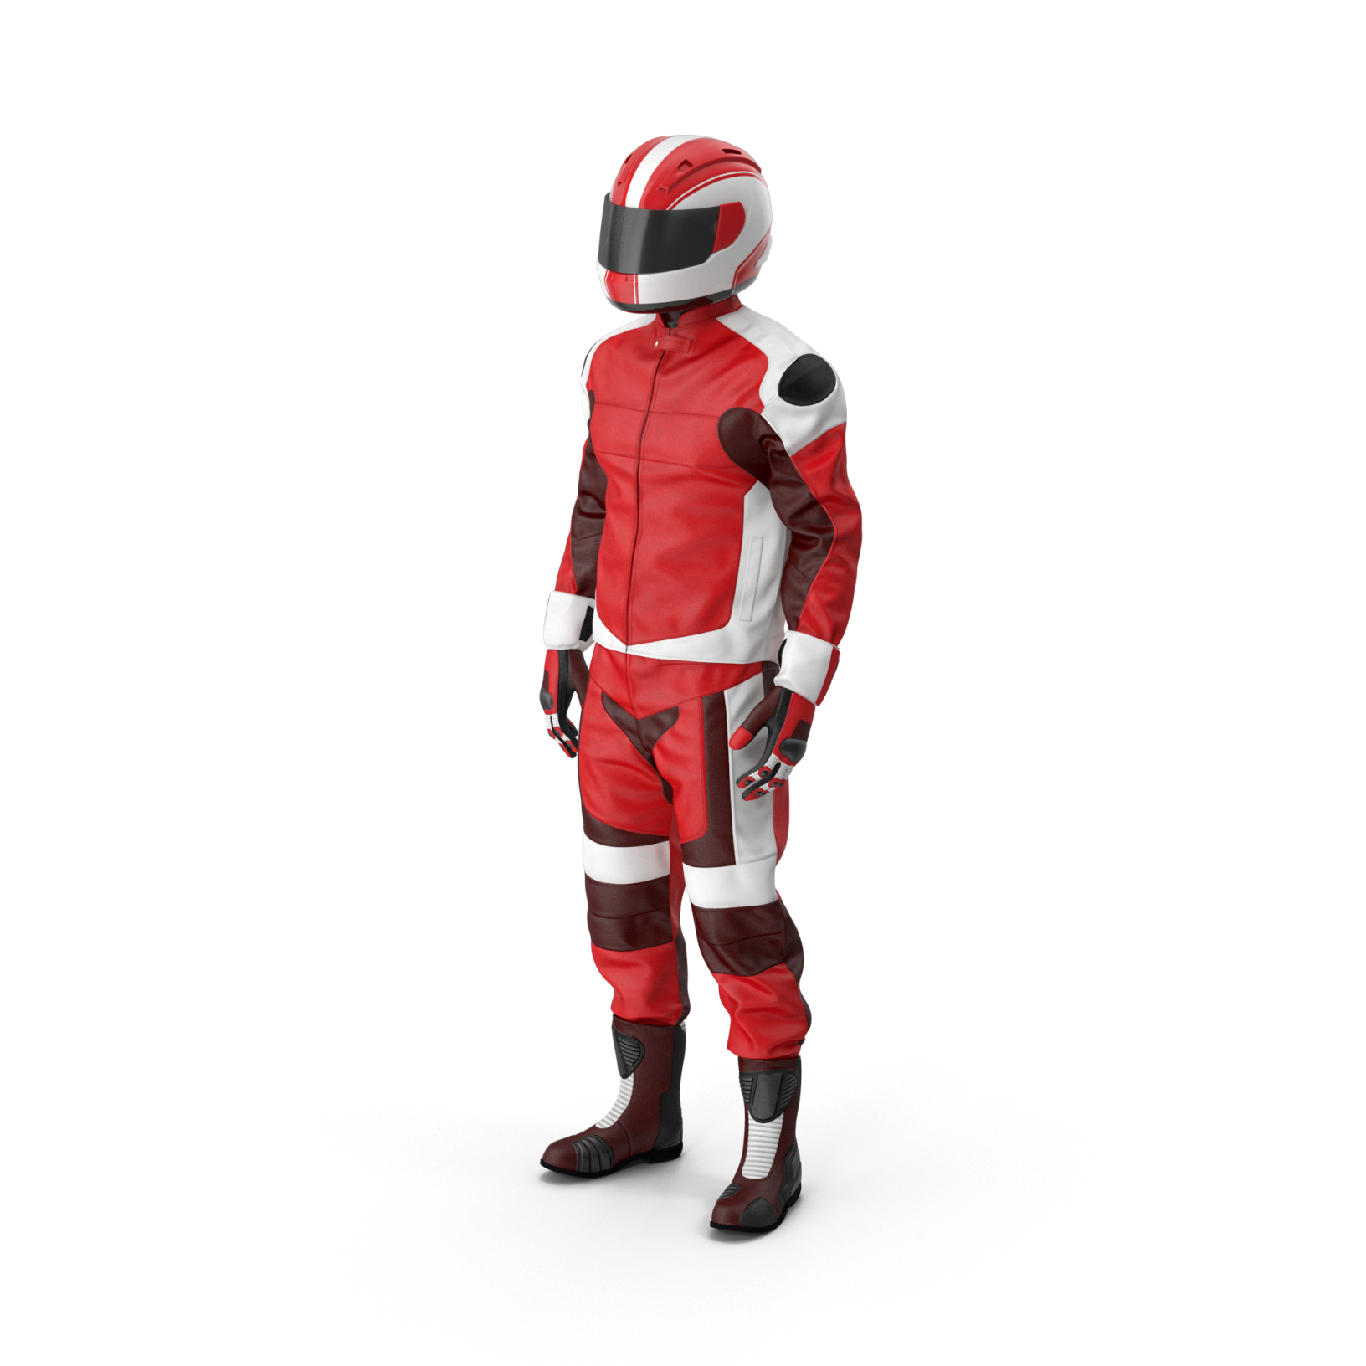
Motorcycles accounted for 44% of all Private Motor Vehicle (PMV) accidents in FY19.
RIDING TIPS
SEEing is the best way to avoid dangerous situations.
SEARCH around you for potential hazards.
EVALUATE any possible hazards such as turning hazard.
EXECUTE the proper action to avoid the hazard.
A sound street strategy can prevent a dangerous situation.
REMEMBER:
ALL sailors shall complete LEVEL I training prior to operating a motorcycle and then must complete LEVEL II training within 60 days of LEVEL I.
ALL sailors shall complete either LEVEL II or LEVEL III refresher training every three years.
Stock Image via Envato Elements

Slide 23
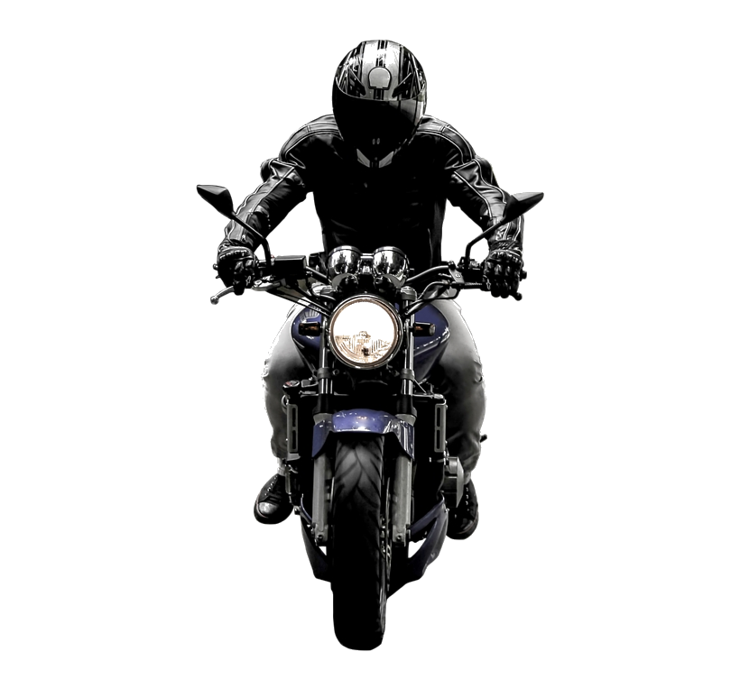
MOTORCYCLE SAFETY
What`s Required?
1. Helmets that are certified to meet DOT standards
2. Impact- or shatter-resistant goggles, wrap around glasses, or full-face shield.
3. Sturdy footwear, leather boots, or over-the-ankle shoes.
4. A long-sleeved shirt or jacket, long trousers, and full-fingered gloves or mittens designed for use on a motorcycle.
Riders are highly encouraged to select Personal Protective Equipment (PPE) that incorporates protective padding, fluorescent colors, and retro-reflective material.
PPE - IT`S WORTH EVERY DIME, EVERY TIME!
Stock Image via Envato Elements

Slide 24
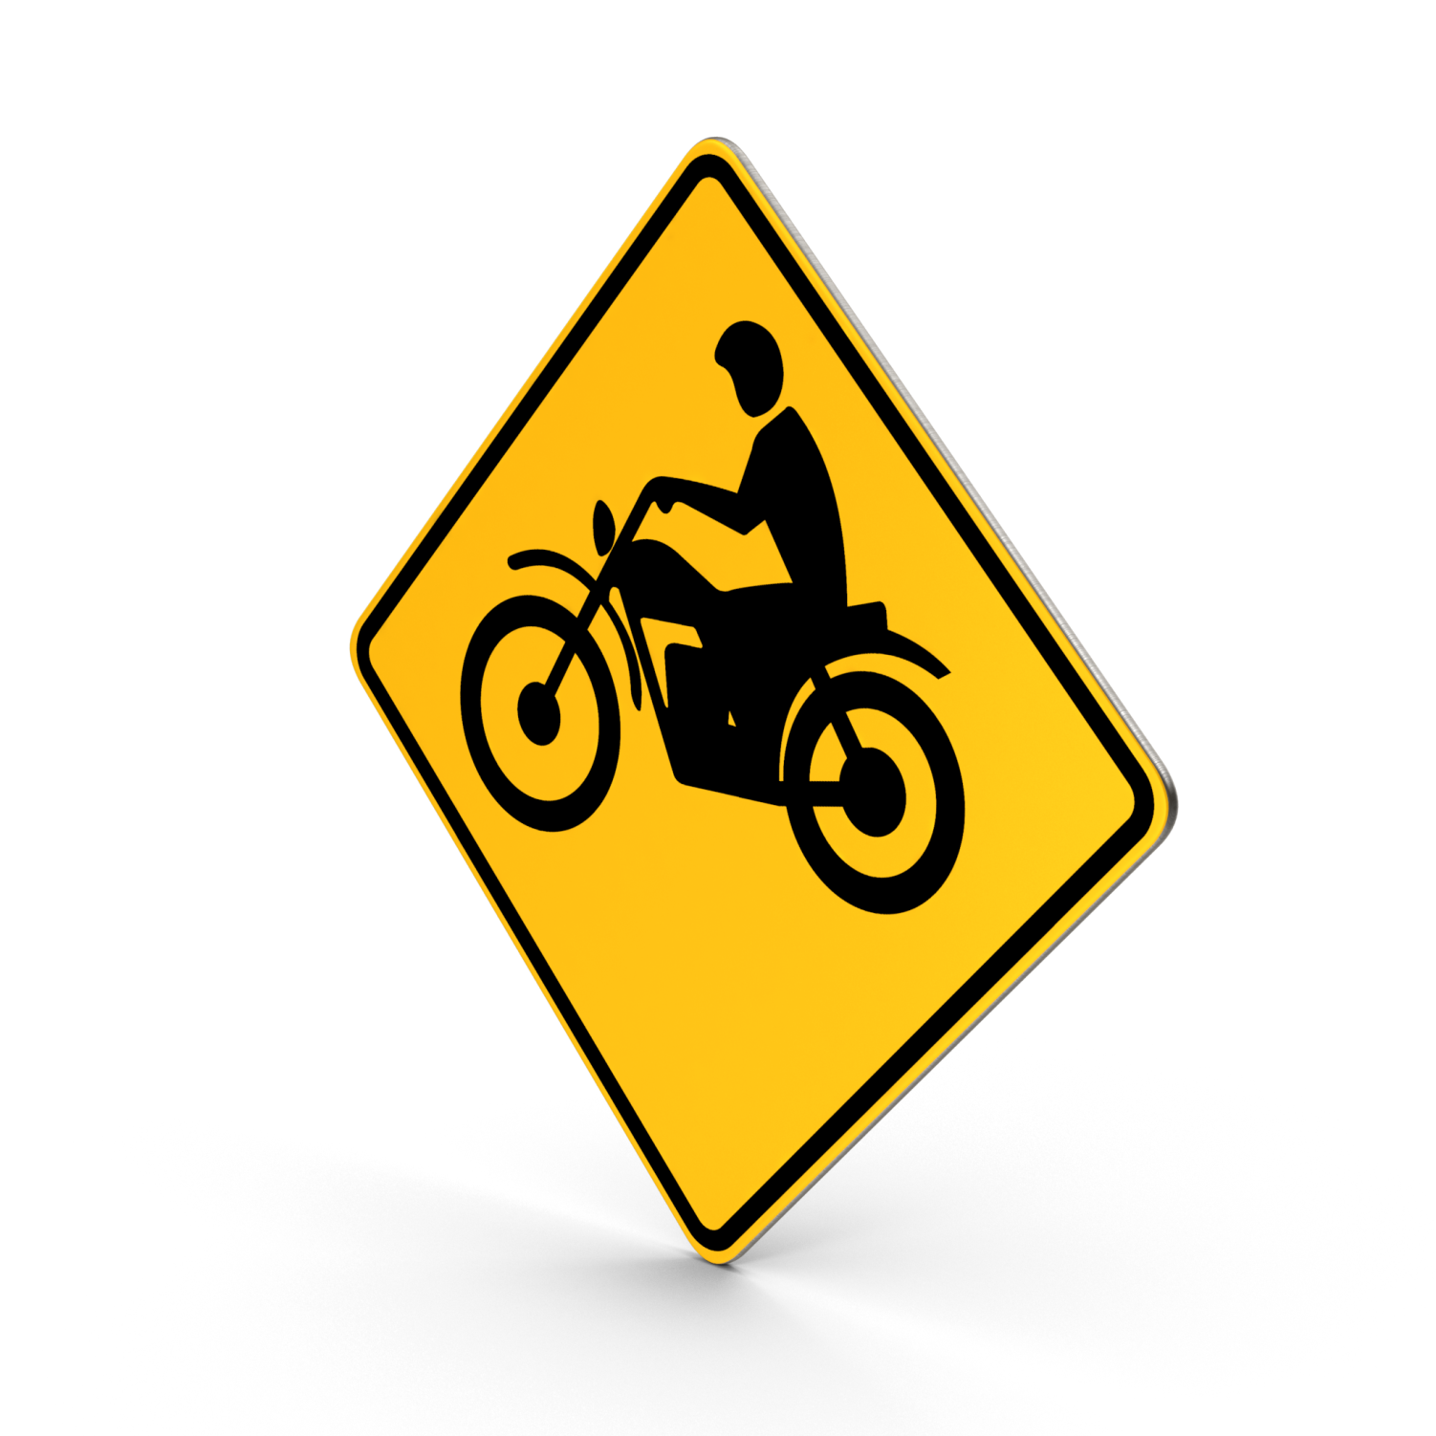
MOTORCYCLE SAFETY TIPS
Make motorcycle riding safety your top priority!
It’s important to understand some basic motorcycle safety tips to make sure your next ride is a safe one.
Follow these tips for safe riding:
Always wear a helmet with a face shield or protective eye wear.
Wearing a helmet is the best way to protect against severe head injuries. A motorcycle rider not wearing a helmet is five times more likely to sustain a critical head injury.
Wear appropriate gear.
Make sure to wear protective gear and clothing that will minimize the amount of injuries in case of an accident or a skid. Wearing leather clothing, boots with nonskid soles, and gloves can protect your body from severe injuries. Consider attaching reflective tape to your clothing to make it easier for other drivers to see you.
Stock Image via Envato Elements

Slide 25
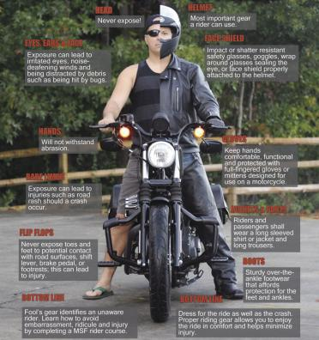
MOTORCYCLE SAFETY TIPS
Follow traffic rules.
Obey the speed limit; the faster you go the longer it will take you to stop. Be aware of local traffic laws and rules of the road.
Ride Defensively
Don’t assume that a driver can see you, as nearly two-thirds of all motorcycle accidents are caused by a driver violating a rider’s right of way. You should always ride with your headlights on; stay out of a driver’s blind spot; signal well in advance of any change in direction; and watch for turning vehicles.
Keep your riding skills honed through education.
Complete a formal riding education program, get licensed, and take riding courses from time to time to develop riding techniques and to sharpen your street-riding strategies.

Slide 26
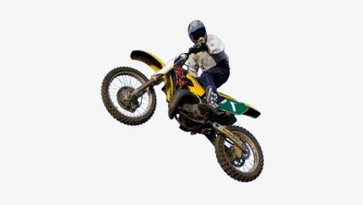
MOTORCYCLE SAFETY TIPS
Be awake and ride sober.
Don’t drink and ride, you could cause harm to yourself and others. Additionally, fatigue and drowsiness can impair your ability to react, so make sure that you are well rested when you hit the road.
Preparing To Ride
Making sure that your motorcycle is fit for the road is just as important as practicing safe riding. Should something be wrong with your motorcycle, it will be in your best interest to find out prior to hitting the road.
Stock Image via Envato Elements

Slide 27
MOTORCYCLE SAFETY TIPS
To make sure that your motorcycle is in good working order, check the following:
Tires: Check for any cracks or bulges, or signs of wear in the treads (low tire pressure or any defects could cause a blowout)
Under the motorcycle: Look for signs of oil or gas leaks
Headlight, taillight and signals: Test for high and low beams (make sure that all lights are functioning)
Hydraulic and coolant fluids: Level should be checked weekly
Once you’ve mounted the motorcycle, complete the following checks:
Clutch and throttle: Make sure they are working smoothly (throttle should snap back when released)
Mirrors: Clean and adjust all mirrors to ensure sharpest viewing
Brakes: Test front and rear brakes (each brake should feel firm and hold the motorcycle still when fully applied)
Horn: Test the horn
Image by Harvey Davidson Unsplash

Slide 28
PEDESTRIAN SAFETY
In 2018, 24 personnel were killed crossing a street or walking too near a roadway.
Three were intoxicated.
Three Sailors were killed in the vicinity of a fender bender or disabled vehicle.
See and be seen.
Use the crosswalk.
Use all your senses when near an area with moving vehicles.
Look left, right, and then left again.
Avoid walking when impaired by alcohol.
It goes without saying: Obey ALL traffic laws.

Slide 29
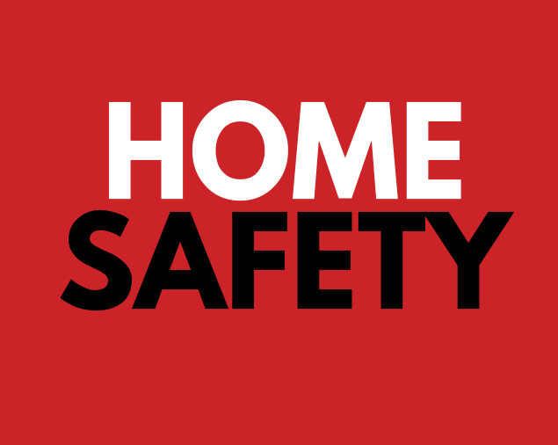
Each year an average of 8,900 home fires are caused by grilling.

Slide 30
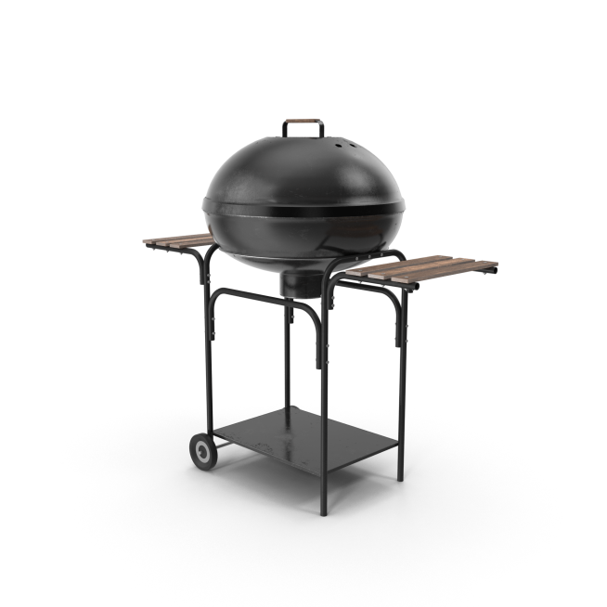
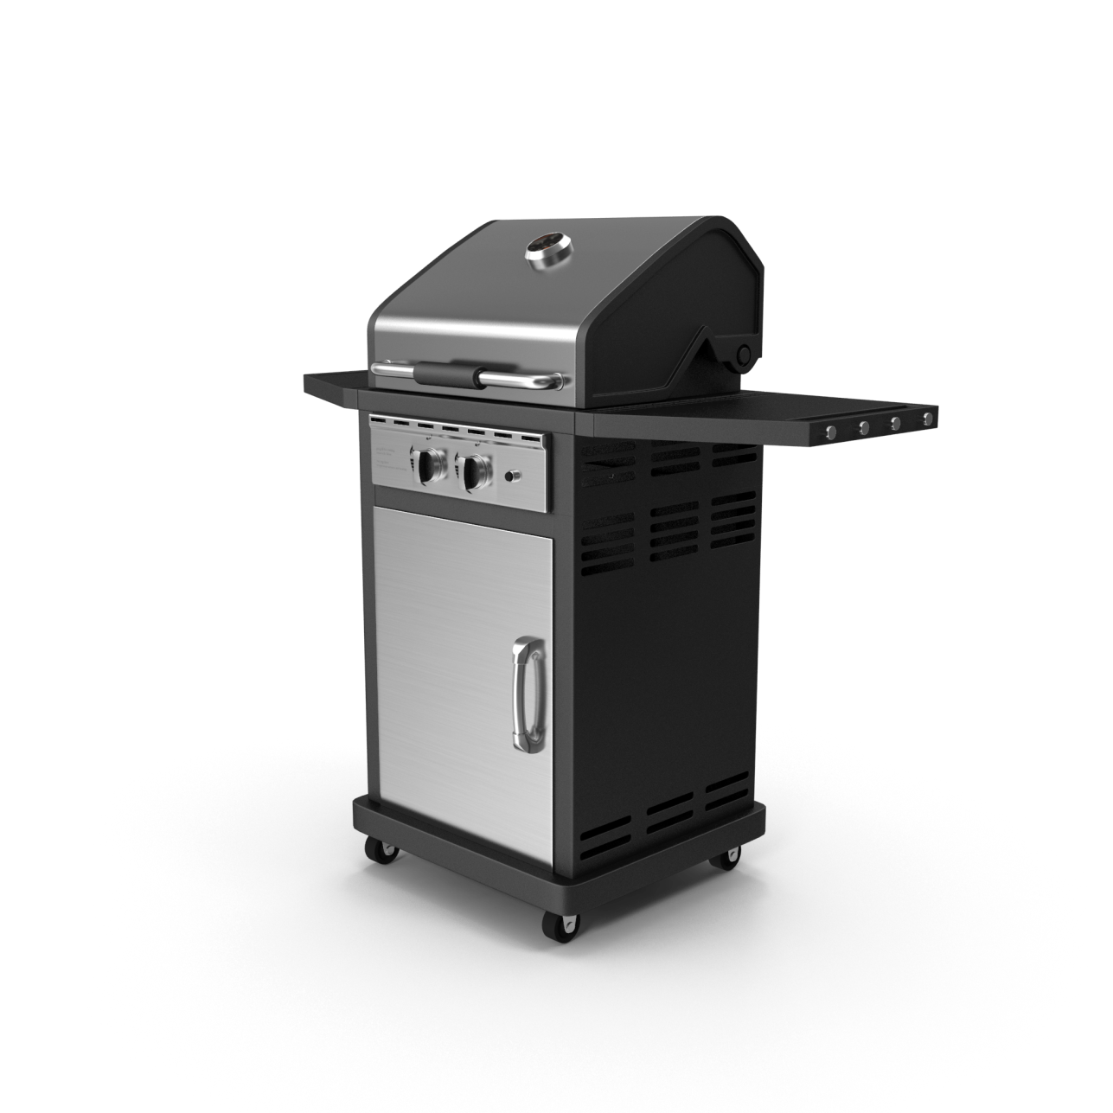
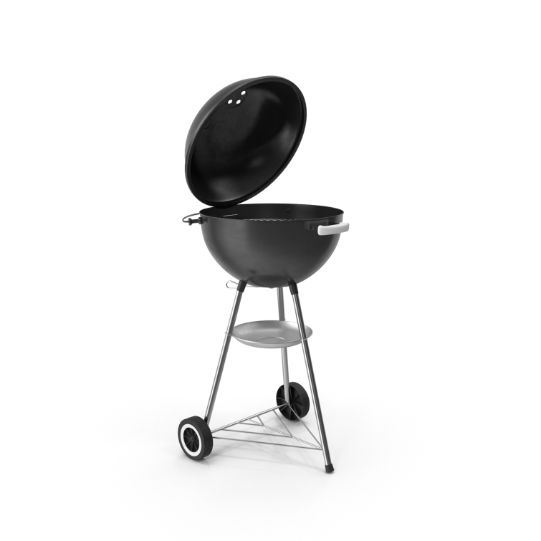
Safety Tips when Grilling:
Use grill outside ONLY, away from siding, deck rails, and overhanging branches.
Periodically remove grease buildup.
NEVER add charcoal starter fluid to fire.
NEVER use gasoline or any flammable liquids other than starter fluid.
Check the gas cylinder hose for leaks.
U.S. fire departments responded to an estimated average of 358,500 home structure fires per year during 2011-2015, which represents 3/4 of all structure fires.
Home fires cause an annual average of 2,510 civilian fire deaths and 12,300 fire injuries.
Stock Images via Envato Elements

Slide 31
Notes:
There are many ways to be injured both on-duty ad off-duty. This Top 10 shows a comparison of FY-19 totals vs. during the 101 Critical Days of Summer period.
PMV: 842 vs. 220, 26 percent of this injury type occurs during the 101 Critical Days period.
Walking/Stepping/Marching: 211 vs 66, 31 percent “ “
Basketball: 188 vs 64, 34 percent “ “
Other: 142 vs 47, 33 percent “ “
Football: 98 vs 28, 29 percent “ “
Ascending/Descending Stairs or Steps: 76 vs 26, 34 percent
Running/Jogging (non PT exercise): 61 vs 18, 30 percent “ “
Soccer: 54 vs 25, 46 percent “ “
Bicycling: 52 vs 19, 37 percent “ “
Baseball/Softball: 51 vs 22, 43 percent

Slide 32
www.NavalSafetyCenter.Navy.mil

